Slide 1

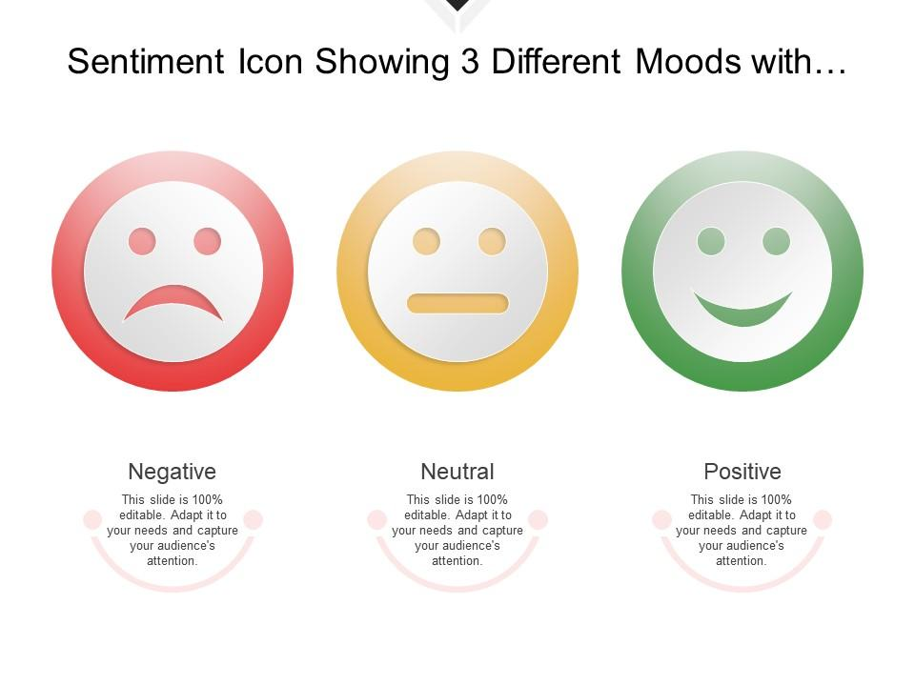
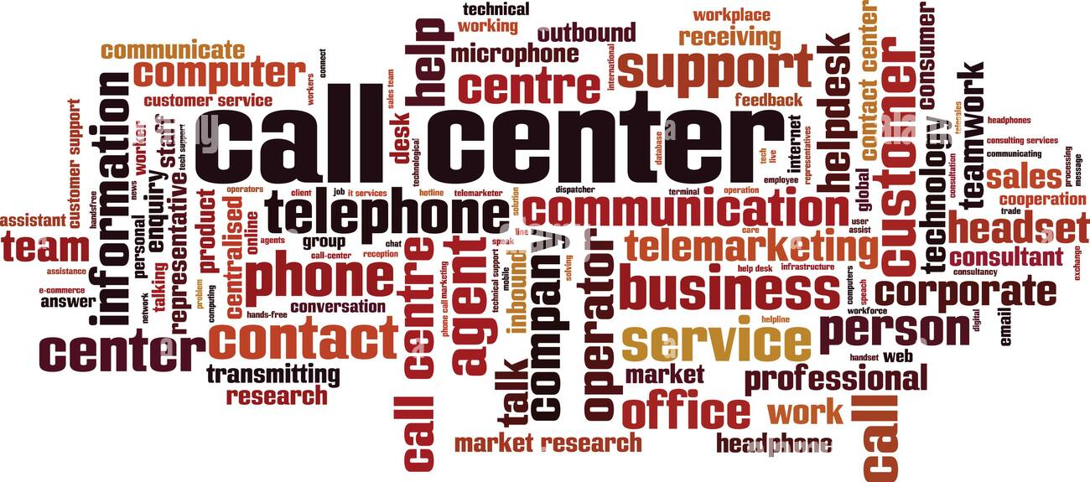
ENRICHING CUSTOMER EXPERIENCE THROUGH SENTIMENT ANALYSIS IN THE BANKING, FINANCIAL SERVICES AND INSURANCE SECTOR: A CASE OF NATIONAL BANK
By:
Mahesh Purbia
Roll No : 21222004
MTech (Decision Sciences and Engineering)
Under the guidance of:
Prof. Prabhas Bharadwaj (supervisor)

Slide 2




Outline
Introduction
Research Motivation
Problem & Dataset Description
Solution Approach
Conclusion &
Future Scope

Slide 3
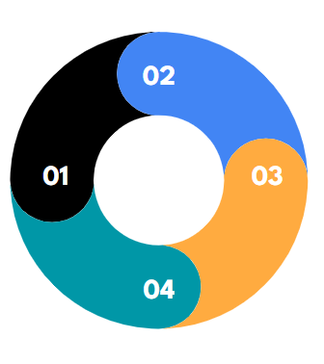
01
Introduction
Why Customer Satisfaction Matters in BFSI
What is BFSI Sector
Sentiment analysis approaches
Challenges in Implementing Sentiment Analysis in the BFSI Sector

Slide 4
INTRODUCTION
What is BFSI Sector?
BFSI stands for Banking, Financial Services, and Insurance sector.
It encompasses various financial institutions, including banks, credit unions, investment firms, insurance companies, and other financial service providers.
How the BFSI Sector Operates ?
Banks provide services such as deposits, loans, and payment processing.
Financial services include investment management, brokerage, financial planning, and advisory services.
Insurance companies offer policies to protect individuals and businesses against risks and provide financial compensation in case of losses.

Slide 5
Why Customer Satisfaction Matters in BFSI
Customer satisfaction is crucial for the BFSI sector as it build up trust, loyalty, and long-term relationships.
Satisfied customers are more likely to continue using BFSI products and recommend them to others.
Positive customer experiences contribute to the reputation and brand image of BFSI organizations, attracting new customers and retaining existing ones.

Slide 6
What is Sentiment analysis
Sentiment analysis measures satisfaction: Sentiment analysis techniques can be used to assess and measure customer satisfaction
The goal of sentiment analysis is to determine the overall sentiment or emotional tone of the text, whether it is positive, negative, or neutral. It goes beyond simple keyword analysis and takes into account the context, language nuances, and linguistic patterns to understand the sentiment behind the words.

Slide 7
Traditional methods to identify customer sentiment.
Customer feedback obtained from surveys, Questionnaires
Social Media Monitoring: Tracking customer sentiments expressed on platforms like Twitter, WhatsApp, Instagram, and other social media channels.
Text Messages: Analyzing customer sentiments conveyed through text messages or SMS interactions.
Email Communication: Reviewing customer sentiments expressed through email communications with the organization.
Call Center Interactions: Monitoring and analyzing customer sentiments expressed during phone calls with the call center representatives.
Source : (Tara Ramroop, 2023)

Slide 8
Extracting Customer Sentiments through Call Center Interactions
Call center interactions provide a valuable source of customer feedback and sentiment analysis.
Skilled representatives can actively listen to customers, analyze tone, emotions, and expressions to gauge sentiments accurately.
Leveraging call center interactions for sentiment analysis helps identify trends, address customer needs, and enhance overall customer experiences.

Slide 9
Challenges in Implementing Sentiment Analysis in the BFSI Sector
text
Source : Major Challenges to Text Mining in Finance (Gupta et al., 2020)

Slide 10
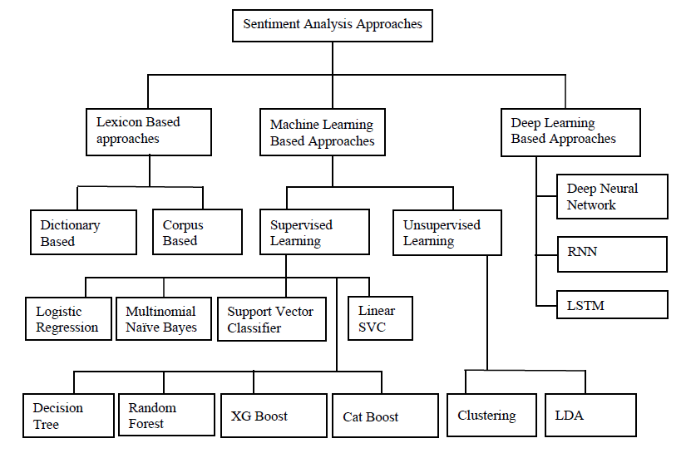
Sentiment analysis approaches

Slide 11

02
Research Motivation

Slide 12
Research Motivation
Personal Curiosity: This research is driven by a personal curiosity and passion for the analysis of textual data to improve business outcomes.
Practical Relevance: By focusing on sentiment analysis, practical insights and recommendations can be derived that directly benefit National Bank and other organizations in the BFSI sector.
Organizational Collaboration: This research Conducted in collaboration with National Bank to research explores the potential of sentiment analysis to enrich customer experience. By leveraging valuable resources and expertise, the study aims to generate practical recommendations tailored to address specific challenges and opportunities faced by the bank. By closely working with the bank, address specific challenges and opportunities faced by National Bank.

Slide 13
Text Mining Application in Finance
Stock Price Prediction :
Predicted stock price movements of 4 enterprises “Amazon, Apple, Microsoft, and Google” based on social media data and historical information utilizing DT for Classification (Tien Thanh Vu et al., 2012).
Analyzing postings from 824 firms in six distinct sectors, including pharmacy, software, health sector, hotel, and savings institutions to investigate influence of social media data on the stock market performance using Naïve Bayes Classifier and considered stock return value and risk for performance evaluation. (Yu et al., 2013).
Incorporating features from time series data and social networks improves stock price prediction performance using a Multiple Kernel Learning (MKL) regression framework. (Deng et al. , 2011)
Stock market analysis system utilizing LDA and kernel k-means clustering to identify important events and their market effects using raw Sensex data and capital market news from the Indian Stock Exchange (Dey et al., 2009).

Slide 14
NLP in FinTech for Financial Document Analysis: Exploring the role of NLP in Know Your Customer (KYC), Know Your Product (KYP), and Satisfy Your Customer (SYC) scenarios in the FinTech industry, analyzing both formal and informal textual data (Chen et al., 2020).
Risk Assessment : Analyzing text data from CEO letters and outlook sections of annual bank reports to measure a bank's attitude towards risk, highlighting opportunities and limitations in using sentiment analysis for risk assessments (Nopp & Hanbury, 2015).
Emerging Trends in Text Mining Applications in Finance : Survey by Kumar and Ravi (2016) reviewed 89 research papers on text mining applications in finance, including stock market prediction, FOREX rate prediction, CRM, and cyber security. The survey identifies key issues, research gaps, and future directions.

Slide 15
Research Gap
Limited research on sentiment analysis specifically for customer call centers in the BFSI sector.
Existing studies often overlook the unique characteristics and challenges of sentiment analysis in the BFSI sector.
Need for investigating the effectiveness of sentiment analysis in improving customer experience in BFSI call centers.
Potential gap in understanding and leveraging customer sentiment expressed during interactions with call center representatives in the BFSI sector.

Slide 16
03
Problem and Dataset Description

Slide 17
Problem Description
Understanding customer sentiment is crucial for improving customer satisfaction and loyalty in the competitive BFSI sector.
Bank call centers collect a large volume of customer interaction data, which holds valuable insights into customer sentiment towards bank products and services.
Manual review and categorization of call center interactions for sentiment analysis are time-consuming and inefficient.
There is a need for an automated sentiment analysis tool that can accurately categorize customer sentiments as neutral, negative, or positive based on transcribed call center conversations.
The development of such a tool would enable banks to efficiently analyze customer sentiment and make data-driven decisions to enhance customer satisfaction and loyalty.

Slide 18
Objective
Build a multiclass sentiment classification model specifically for a nationalized bank using call center transcribed dataset.
Provide the nationalized bank with a reliable tool to analyze and understand customer sentiments expressed in call center interactions, enabling them to make informed decisions and improve customer experience.

Slide 19
Dataset Description
Disclaimer : Due to a non-disclosure agreement, specific details about the dataset of this particular bank cannot be disclosed. However, it is essential to note that the dataset utilized in this study consists of a collection of 812 transcribed call center conversations from a bank’s customer service interactions.
Below is the snapshot of data used in the study.
Figure : Dataset used in the Study

Slide 20


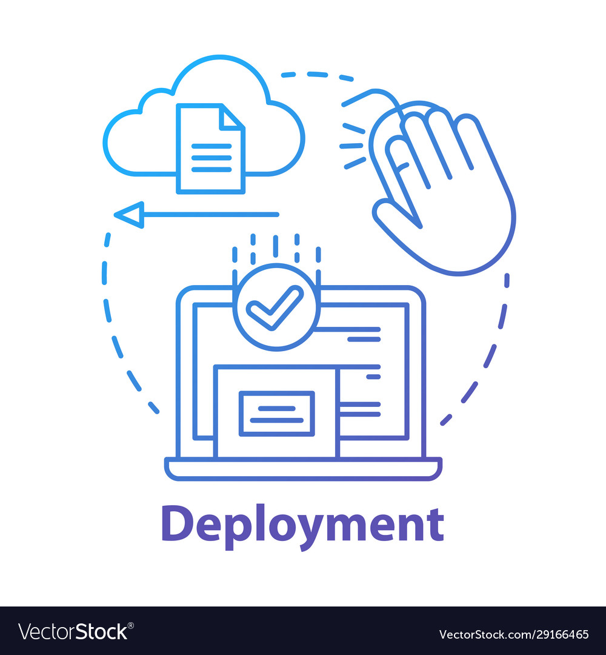
04
Solution Approach
Phase - 1
Phase - 2
Phase - 3
Lexicon Based Method
Supervised ML for Sentiment Classification
Model Deployment

Slide 21
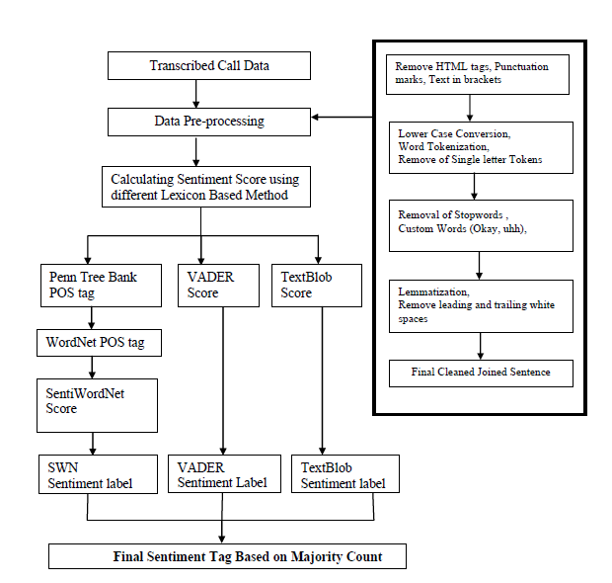
Lexicon Based Sentiment Analysis Framework

Slide 22
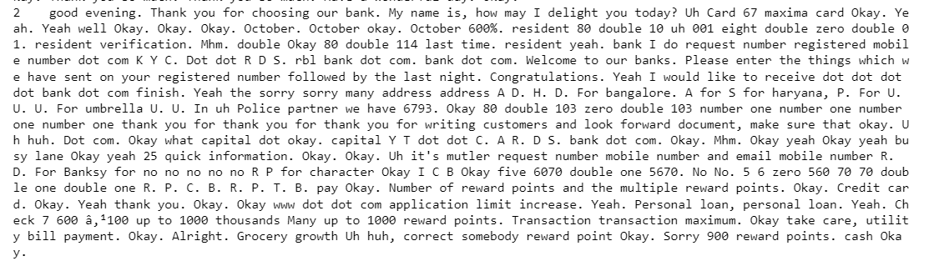
Data Pre-Processing
Analyzed Transcribed Dataset
Figure : Transcribed call Review for analysis

Slide 23
Data Cleaning Steps
Remove HTML tags and content within square brackets.
Eliminate non-alphabetic characters and special characters.
Remove punctuation marks to ensure text consistency.
Text Normalization
Text normalization is the process of transforming text into a standard and consistent format to reduce variations and ensure uniformity in the text data. It involves applying a set of techniques to make the text more suitable for analysis and modeling.
Convert text to lowercase to ensure case insensitivity.
Tokenize the text by splitting it into individual words or tokens.
Remove stopwords (commonly used words with little semantic value) and custom stopwords.
Lemmatize tokens to reduce words to their base form.

Slide 24
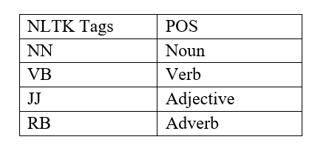
Text Pre-Processing for SentiWordNet
Parts of Speech (POS) Tagging : It involves assigning grammatical tags to each word in a sentence, indicating its part of speech “(e.g., noun, verb, adjective).” POS tagging is essential for SentiWordNet because sentiment scores are assigned at the synset level, and knowing the correct POS tag helps in matching words with their corresponding synsets.
NLTK POS Tags (Santorini, 1990):
WordNet POS Tags: (Miller & Fellbaum, 1998)

Slide 25
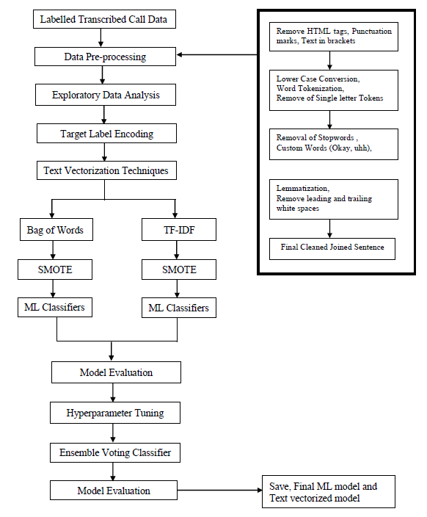
Supervised ML Approach for Sentiment Classification

Slide 26
DATA PRE-PROCESSING
The exact steps for text cleaning were followed as those used during sentiment label generation using lexicon-based models.

Slide 27
EXPLORATORY DATA ANALYSIS
Frequency of Label Data

Slide 28
Word Cloud Formation for each Sentiment Class

Slide 30
Train Test Split
Split the original dataset of 812 call center conversations into train data and test data by applying the train test split function with a test size of 0.3, resulting in a training dataset with 568 samples and a testing dataset with 244 samples.
Text Vectorization Techniques
Whenever we apply any algorithm in NLP, it works on numbers. Because ML algorithms cannot operate directly with raw text, it must be transformed into well-defined vectors of real numbers
1. Bag of words (BOW)
2. Term frequency and Inverse document Frequency (TFIDF)

Slide 31
Bag-of-Words
It involves two steps, i.e.,
(i) Creating a vocabulary of known words
(ii) Measuring the occurrence of these words within the text.
BOW only cares about the occurrence of words within a document and their count without considering the order of words in the sentence or document
TF-IDF
It calculates the importance of a term in a document by considering its frequency in the document (TF) and its rarity across the entire corpus (IDF)
TF-IDF is the product of TF and IDF. The higher score indicates the greater importance of the word in the corpus.

Slide 32
SMOTE (Synthetic Minority Over-sampling Technique)
The SMOTE algorithm selects a minority class instance and identifies its nearest neighbors. It then generates synthetic instances along the line segments connecting the instance and its neighbors in the feature space.

Slide 34
ML Model Evaluation on BOW features

Slide 35
ML Model Evaluation on TF-IDF features

Slide 36
Best Performing Model : BOW Features
XG Boost Classifier - Accuracy: 0.9016, Precision: 0.8917, Recall: 0.9016, F1-Score: 0.8763
Logistic Regression - Accuracy: 0.8811, Precision: 0.8724, Recall: 0.8811, F1-Score: 0.8759
Linear SVC - Accuracy: 0.8730, Precision: 0.8735, Recall: 0.8730, F1-Score: 0.8732
Ensemble Modelling
Ensemble modeling is a powerful approach that aims to improve the overall performance and robustness of machine learning models by leveraging the collective intelligence of multiple models.
Voting Ensemble, which combines the predictions from multiple models using a majority voting strategy. The idea is to consider the predictions from each model and select the class label that receives the most votes

Slide 37
Ensemble Voting Classifier on BOW Features Results

Slide 38
Receiver Operating Characteristic - Ensemble Classifier (BOW)
ROC AUC Scores Ensemble Classifier (BOW):
[0.82 0.87 0.86]
Macro-average ROC AUC Ensemble Classifier (BOW): 0.8539
Micro-average ROC AUC Ensemble Classifier (BOW): 0.9699

Slide 39
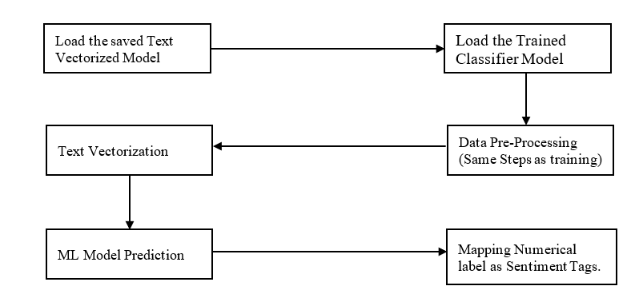
Model Deployment

Slide 40
05
Conclusions and Future Scope

Slide 41
Conclusions
The research project successfully developed a robust sentiment analysis model specifically tailored for bank call center transcribed data.
The combination of lexicon-based methods and machine learning algorithms with optimized parameters yielded accurate sentiment classification results.
The ensemble voting classifier, trained on the Bag-of-Words (BOW) representation, resulted achieved an accuracy of 0.89, precision of 0.88, recall of 0.89, and F1 score of 0.88, indicating its effectiveness in accurately classifying customer sentiments.
The individual class ROC AUC scores for negative, neutral, and positive sentiments were 0.82, 0.87, and 0.86, respectively, demonstrating the model's ability to distinguish between sentiment classes.
Also, micro-average ROC AUC of 0.9699 and a macro-average ROC AUC of 0.8539, further highlighting the model's effectiveness in sentiment classification across all classes.

Slide 42
Scope for Future Work
While this research project has made significant progress in developing an effective sentiment analysis model for bank call center transcribed data, there are several avenues for future exploration and improvement.
Deep Learning Approaches : Explore RNNs, LSTM networks, or transformers for sentiment classification in bank call center conversations, capturing complex patterns and improving sentiment understanding.
Domain Adaptation : Adapt the model to the banking domain by incorporating banking-specific knowledge, such as lexicons and financial sentiment dictionaries, for accurate sentiment analysis.
Multilingual Sentiment Analysis : Develop multilingual sentiment analysis models to effectively classify sentiments in different languages, leveraging techniques like transfer learning and cross-lingual models to enhance sentiment analysis in a globalized banking industry.

Slide 43
THANK YOU!

